Slide 1

NETW211 Course Project Module 2 Virtual Machine (VM) Instances Edward Alvarado March 2022

Slide 2
Rubric
Activity | Requirement(s) | Points
Deploying a VM in Azure | Screenshot | 10
Connecting to the VM | Screenshot | 10
Deleting the VM | Screenshot | 10

Slide 3
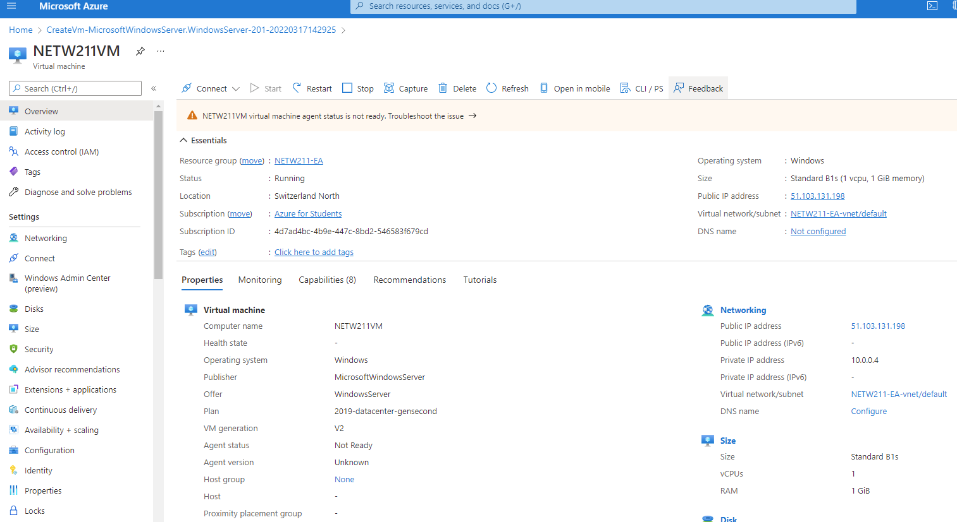
Deploying a VM in Azure
This screenshot should show the NETW211VM page with information such as the resource group name, subscription, public IP address, etc.

Slide 4
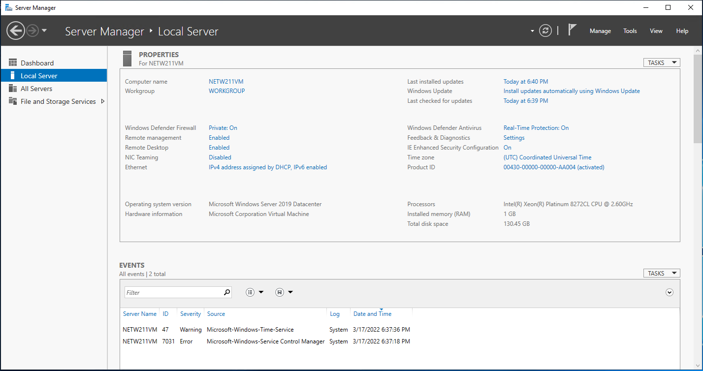
Connecting to the VM
This screenshot should show the PROPERTIES for NETW211VM page, with the computer name, operating system version, hardware information, etc.

Slide 5
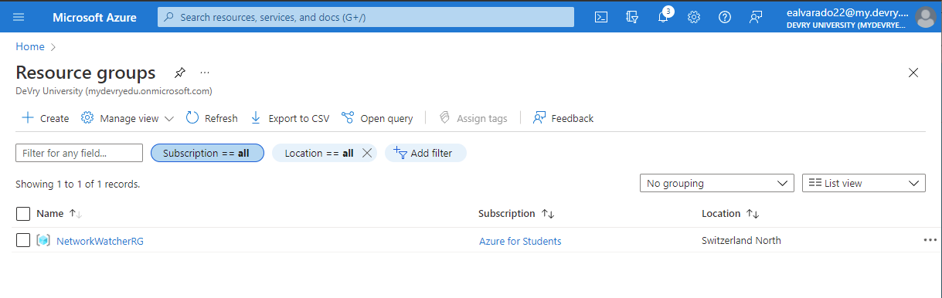
Deleting
the VM
This screenshot should show the Resource groups page, with the Azure for Students subscription selection and the “No resource groups to display” message.

